Slide 1
B+ Trees Indexing
Dr. Shaheen Khatoon
Application
program
DBMS
End-user
1-<number>

Slide 2

Indexes: Review
Indexing mechanisms used to speed up access to desired data.
Search Key - attribute to set of attributes used to look up records in a file.
An index file consists of records (called index entries) of the form
Index files are typically much smaller than the original file
Two basic kinds of implementations:
  Tree indices: search keys are stored in sorted order!
  Hash indices: search keys are distributed uniformly across “buckets” using a “hash function”.
1-<number>

Slide 3
Multilevel Index: review
If primary index does not fit in memory, access becomes expensive.
To reduce number of disk accesses to index records, treat primary index kept on disk as a sequential file and construct a sparse index on it.
outer index – a sparse index of primary index
inner index – the primary index file
If even outer index is too large to fit in main memory, yet another level of index can be created, and so on.
Indices at all levels must be updated on insertion or deletion from the file.
1-<number>

Slide 4
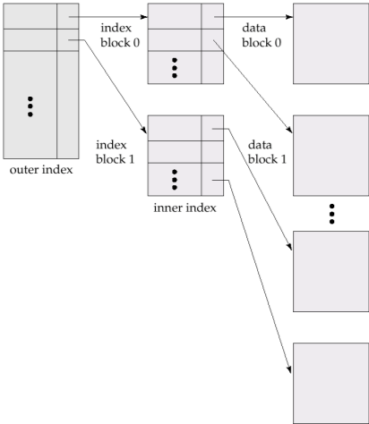
Multilevel Index (Cont.)
Implemented using B Tree
1-<number>

Slide 5
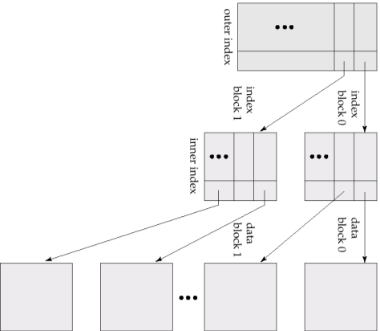
Multilevel Index (Cont.)
Turn multi-lev index upside down—looks like a tree
1-<number>

Slide 6
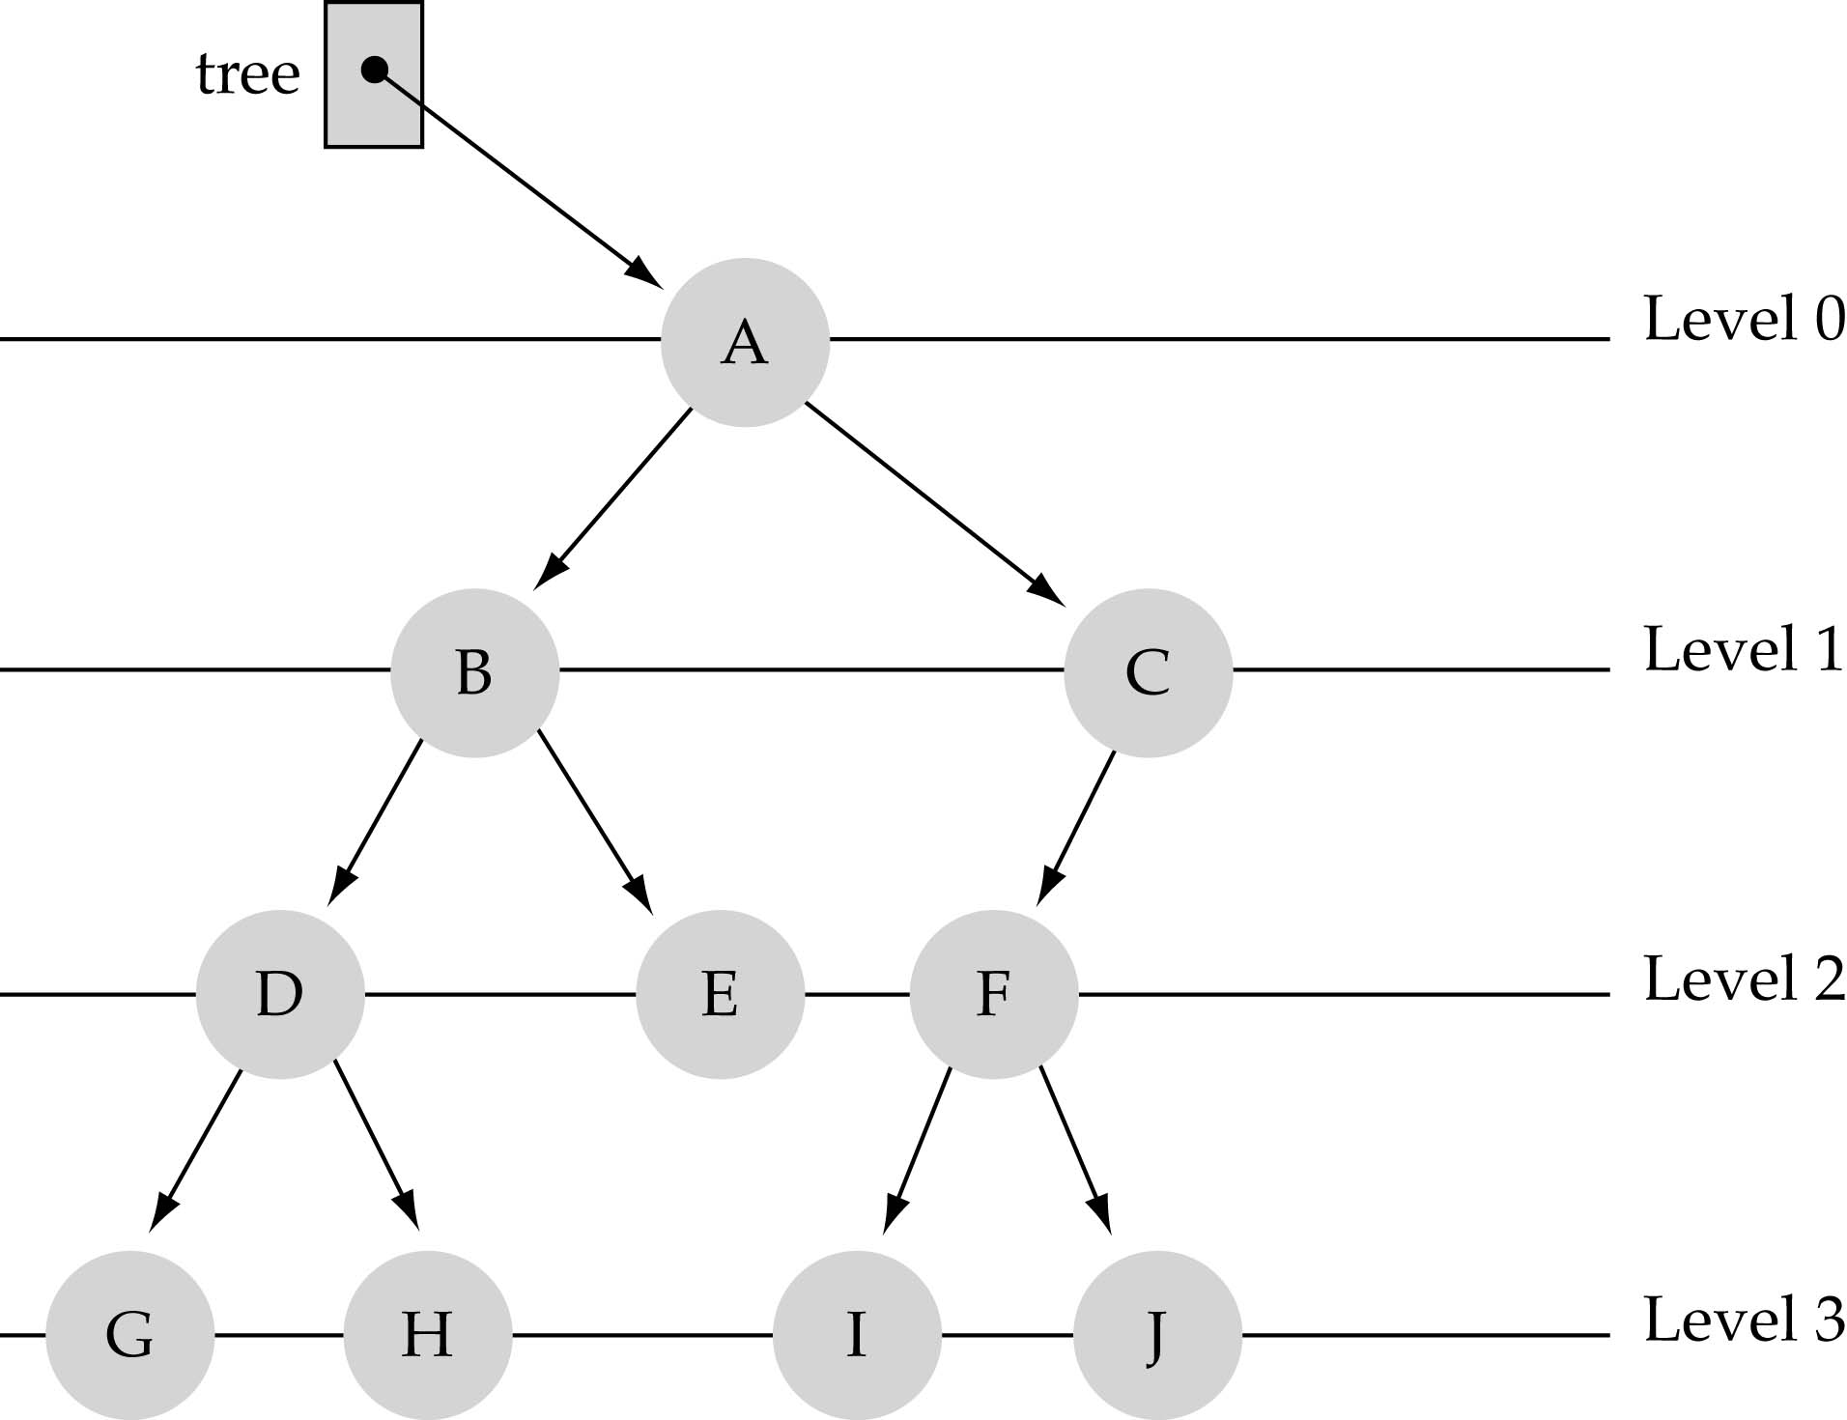
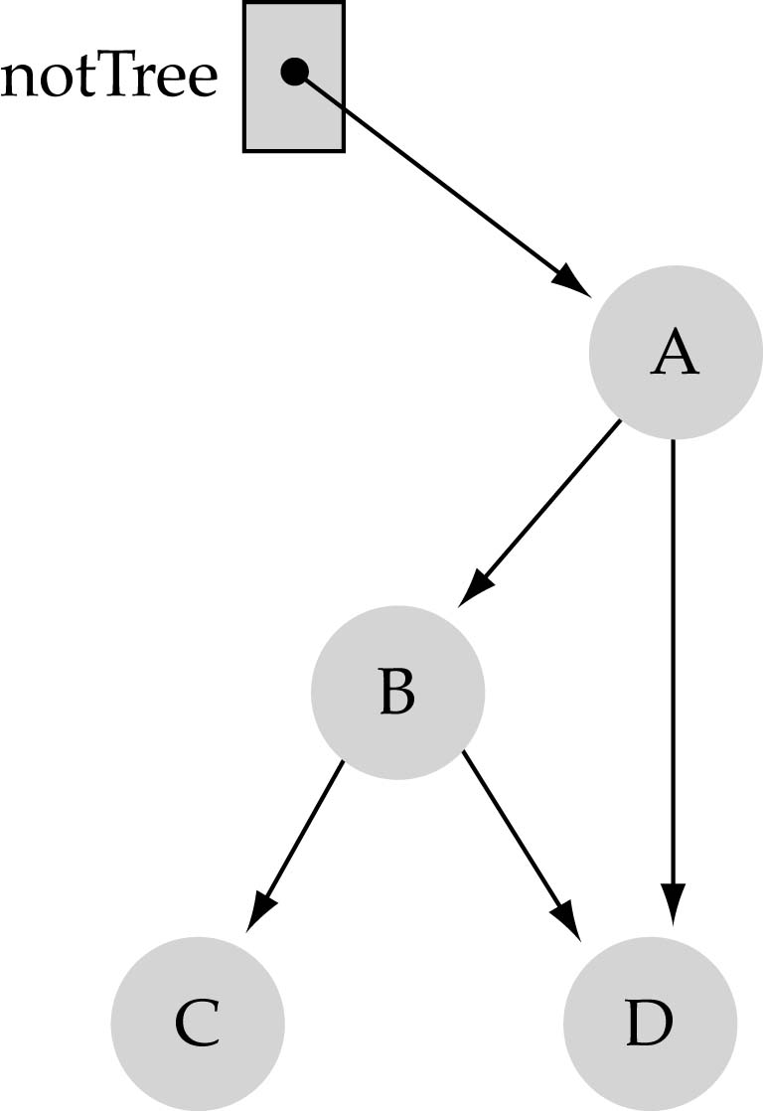
What is a binary tree?
Property 1: each node can have up to two successor nodes.
Property 2: a unique path exists from the root to every other node
Not a valid binary tree!

Slide 7
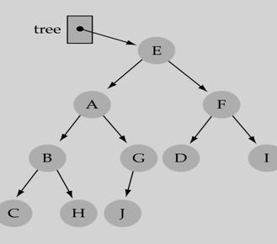
Some terminology
The successor nodes of a node are called its children
The predecessor node of a node is called its parent
The "beginning" node is called the root (has no parent)
A node without children is called a leaf

Slide 8
Some terminology (cont’d)
Nodes are organize in levels (indexed from 0).
Height of a tree h: #levels = L
Full tree: every node has exactly
two children and all the
leaves are on the same level.
not full!

Slide 9
B + tree Indexing: Concept
Each node can have up to n children
  where n is fan out (FO), maximum degree or order of tree.
  Each node can stores n pointer and (n-1) search values
Allow efficient and fast exploration at the expense of using slightly more space.
Support more efficiently queries like:
SELECT * FROM R WHERE a = 11
SELECT * FROM R WHERE 0<= b and b<42

Slide 10
B+ Tree node Structure
Typical node Structure
K_{i} are the search-key values
P_{i} are pointers to children (for non-leaf nodes) or pointers to records (for leaf nodes).
The search-keys in a node are ordered K₁ < K₂ < K₃ < . . . < K_{n–1}
Each node stored in one disk block
1-<number>

Slide 11
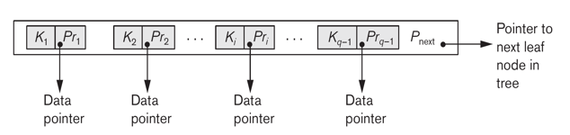
Leaf Node in B+ Tree
For i = 1, 2, . . ., n–1, pointer Pi points to a file record with search-key value Ki
If Li , Lj are leaf nodes and i < j, Li’ s search-key values are less than Lj ‘s search-key values
  Pn points to next leaf node in search-key order
1-<number>

Slide 12
B-tree Indexing: Example
B+ tree of order 4
  Maximum 4 pointer and 3 keys
200
220
250
280
130
9
20
100
200
210
215
250
256
279
280
300
140
145
220
230
Looking for Empno 250
Number of block accesses needed to find a record
= Height of tree (Ht+1)
In this case 3+1 = 4
RID list

Slide 13
Maximum Capacity of B+ Tree
In a 3 level B+ tree with 100 key and 101 pointers in each node:
  we can index as many as a million records (101 * 101 * 100 = 1 million+).
With such an index, accessing a database record requires only 3 index-block read and 1 data-block read. Very efficient!
Given the depth of the tree is 4, with 3 pointers
  Index 3x3x3x2 = 54 records in database. This is the maximum capacity of this B+ tree index.
If we use a B+ tree with order, p = 100, maximum how many records or blocks can we index using a 3-level tree?
  100x100x99 = 990,000 (almost a million)
1-<number>

Slide 14
Searching in B+ Tree
Generalization of binary search
  Give a search key, start from root node
  If key is present in root node then success, else
  If current node is a leaf node and key not present in node, then key not in database
  Search for tree pointer p_{i} such that k_{i-1}<k_{i}<k_{i+1}
  Return step 2 to continue search
1-<number>

Slide 15
Inserting a Data Entry into a B+ Tree
Find correct leaf L.
Put data entry onto L.
  If L has enough space, done!
  Else, must split L (into L and a new node L2)
    Redistribute entries evenly, copy up middle key.
    Insert index entry pointing to L2 into parent of L.
This can happen recursively
  To split index node, redistribute entries evenly, but push up middle key. (Contrast with leaf splits.)
Splits “grow” tree; root split increases height.
  Tree growth: gets wider or one level taller at top.
Notes:
6

Slide 16
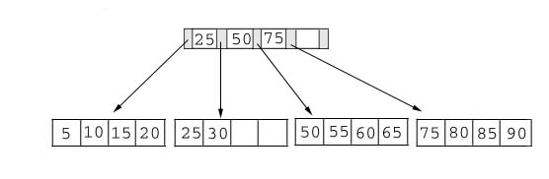
Example of B+ tree
This table shows a B+ tree. As the example illustrates this tree does not have a full index page. (We have room for one more key and pointer in the root page.) In addition, one of the data pages contains empty slots
B+ Tree with four keys

Slide 17
Illustrations of the insert algorithm
The key value determines a record's placement in a B+ tree.
The leaf pages are maintained in sequential order
Doubly linked list connects each leaf page with its sibling page(s).
This doubly linked list speeds data movement as the pages grow and contract.

Slide 18
Illustrations of the insert algorithm
The following examples illustrate each of the insert scenarios.
We begin with the simplest scenario:
  inserting a record into a leaf page that is not full.
  Since only the leaf node containing 25 and 30 contains expansion room, we're going to insert a record with a key value of 28 into the B+ tree.
  The following figures shows the result of this addition.

Slide 19
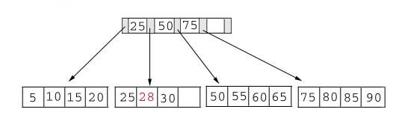
Add to a non-full tree
Add Record with Key 28

Slide 20
Adding a record when the leaf page is full but the index page is not
we're going to insert a record with a key value of 70 into our B+ tree.
This record should go in the leaf page containing 50, 55, 60, and 65.
Unfortunately this page is full. This means that we must split the page as follows
Left Leaf Page Right Leaf Page
50 55 60 65 70

Slide 21
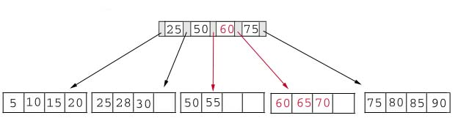
Add Record with Key 70 : Leaf node split example
The middle key of 60 is placed in the index page between 50 and 75.
The following table shows the B+ tree after the addition of 70.

Slide 22
Adding a record when both the leaf page and the index page are full
Add 95 to B+ tree.
This record belongs in the page containing 75, 80, 85, and 90. Since this page is full, split it into two pages:
Left Leaf Page Right Leaf Page
75 80 85 90 95

Slide 23
The middle key, 85, rises to the index page.
Unfortunately, the index page is also full, so we split the index page:
  Left Index Page Right Index Page New Index Page
  25 50 75 85 60

Slide 24
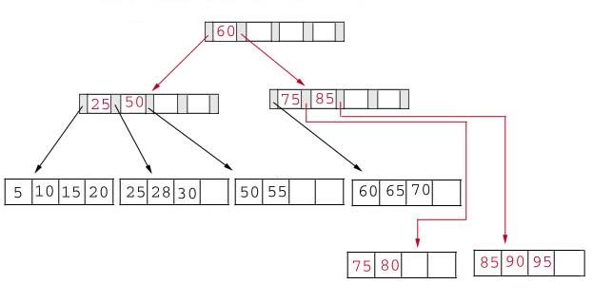
The following table illustrates the addition of the record containing 95 to the B+ tree.

Slide 25
Deleting a Data Entry from a B+ Tree
Start at root, find leaf L where entry belongs.
Remove the entry.
  If L is at least half-full, done!
  If L has less then half entries,
    Try to re-distribute, borrowing from sibling (adjacent node with same parent as L).
    If re-distribution fails, merge L and sibling.
If merge occurred, must delete entry (pointing to L or sibling) from parent of L.
Merge could propagate to root, decreasing height.
Notes:
14

Slide 26
Deleting Keys from a B+ tree
As our example, we consider the B+ tree after we added 95 as a key.
As a refresher this tree is printed in the following table.

Slide 27
Delete 70 from the B+ Tree
We begin by deleting the record with key 70 from the B+ tree.
This record is in a leaf page containing 60, 65 and 70.
This page will contain 2 records after the deletion.
Since our fill factor is 50% or (2 records) we simply delete 70 from the leaf node.
The following table shows the B+ tree after the deletion.

Slide 28
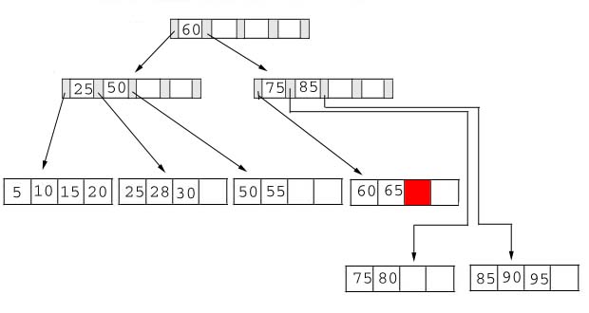
Delete Record with Key 70

Slide 29
Delete 25 from the B+ tree
Delete the record containing 25 from the B+ tree.
This record is found in the leaf node containing 25, 28, and 30.
The fill factor will be 50% after the deletion; however, 25 appears in the index page.
Thus, when we delete 25 we must replace it with 28 in the index page.
1-<number>

Slide 30
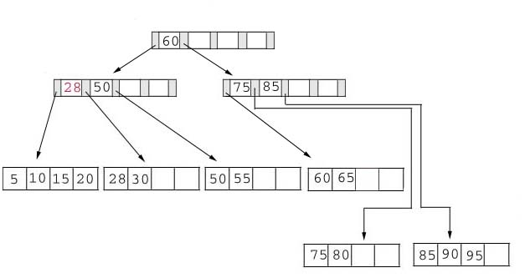
Delete 25 from the B+ tree

Slide 31
Delete 60 from the B+ tree
Delete 60 from the B+ tree. This deletion is interesting for several reasons:
The leaf page containing 60 (60 65) will be below the fill factor after the deletion. Thus, we must combine leaf pages.
With recombined pages, the index page will be reduced by one key. Hence, it will also fall below the fill factor. Thus, we must combine index pages.
Reduce index level: 60 appears as the only key in the root index page. Obviously, it will be removed with the deletion.

Slide 32
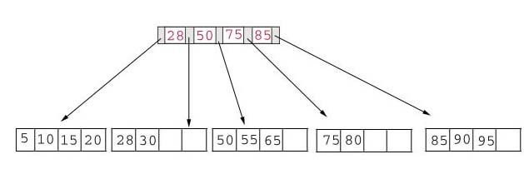
The following table shows the B+ tree after the deletion of 60. Notice that the tree contains a single index page.
Delete Record with Key 60

Slide 33
Exercise
Create an initial B+ tree with a B+-tree with p = 3 and pleaf = 2
  First Insert 8, 5,
  Then insert in the following sequence
    1, 7, 3, 12, 9, 6
  At each insertion observe, if it is increasing width or height of the tree
Deletion Sequence: 5, 12, 9
Use this visualization tool to enhance your understanding:
https://www.cs.usfca.edu/~galles/visualization/BPlusTree.html
1-<number>

Slide 34
Hashing
Provides rapid, non-sequential, direct access to records, by providing a Search Key value
Hashing: A key record field is used to calculate the record address by subjecting it to some calculation; a process called hashing.
  A hash function is computed on some attribute of each record.
  The result of the function specifies in which block of the file the record should be placed
1-<number>
Notes:
A hash function is computed on some attribute of each record. The result of the function specifies in which block of the file the record should be placed .Hashing provides rapid, non-sequential, direct access to records. A key record field is used to calculate the record address by subjecting it to some calculation; a process called hashing. For numeric ascending order a sequential key record fields this might involve simply using relative address indexes from a base storage address to access records. Most of the time, key field does not have the values in sequence that can directly be used as relative record number. It has to be transformed. Hashing involves computing the address of a data item by computing a function on the search key value. A hash function h is a function from the set of all search key values K to the set of all bucket addresses B.

Slide 35
Hashing
A hash structure (or table or file) is a generalization of the simpler notion of an ordinary array
  In an array, an arbitrary position can be examined in O(1)
A hash function h is used to map keys into a range of bucket numbers
0
h(key) mod N
2
key
h
N-1
Primary bucket pages

Slide 36
Hash Indexes
The hash index is a secondary structure to access the file by using hashing on a search key
The index entries are of the type
  <K, Pr> or <K, P>,
  where Pr is a pointer to the record containing the key, or P is a pointer to the block(bucket) containing the record for that key.
1-<number>

Slide 37
Hash-Based Indexing
What indexing technique can we use to support range searches (e.g., “Find s_name where gpa >= 3.0)?
  Tree-Based Indexing
What about equality selections (e.g., “Find s_name where sid = 102”?
  Tree-Based Indexing
  Hash-Based Indexing (cannot support range searches!)

Slide 38
Downsides of Indexes
Extra space
Index creation
Index maintenance

Slide 39
Picking which indexes to create
Benefit of an index depends on:
  Size of table (and possibly layout)
  Data distributions
  Query vs. update load

Slide 40

“Physical design advisors”
Input: database (statistics) and workload
Output: recommended indexes
Database statistics
Query Optimizer
Query or update
Indexes
Best execution plan
with estimated cost

Slide 41
Summary
Indexes
Multilevel Indexes
Dynamic Multilevel Indexes Using B+-Trees
Hash Indexes

